Slide 1

NLP for Classification: The Language of Job Postings
an immediate need for a Data Scientist to join our Analytics Team in Palo Alto, CA
Born out of the MIT Media Lab, Humanyze has created cutting-edge technology for analyzing human interactions and the impact these interactions have on business performance. The company is VC-backed and has already worked with an impressive roster of blue chip clients. Our cutting-edge social sensing and analytics platform, developed at MIT, enables companies to quantify face-to-face as well as digital social interactions. Companies can leverage this information to enhance teamwork and employee engagement, improve processes, and plan for growth.
‪ROLE DESCRIPTION‬
The analytics team is responsible for analyzing customer data in order to generate business insights. The datasets we work with are collected from multiple sources, including email, calendar, calls, and IMs as well as face-to- face collaboration data collected using the Sociometric Badges. With a rapidly growing user base, we are in need of a Data Scientist who would be responsible for creating scalable methods to extract meaningful metrics from large, multi-source datasets. In this role, a Data Scientist would be expected to:
Design and implement new/custom algorithms and methodology for multi-dimensional social network data collected in real-world organizations.
Lead the effort in scaling the analysis for large organizations.
Work on meta-analysis on looking at patterns and benchmarks over multiple organizations.
Work closely with a product engineering team to identify and implement automated solutions.
‪JOB REQUIREMENTS‬
‬MS or PhD degree in Computer Science, Network Science, or related field.
3+ years of experience in social network analysis, machine learning, statistics, or data mining.
Production-level programming skills in Python.
Must work well in multi-disciplinary teams.
. You will help us use that data to connect our users with great local businesses. You will work tightly with the product and engineering team to answer questions ranging from who is more likely to like a flavor of ice cream to which experimental features move the needle... and you’ll help us define the needle. You’ll ask critical questions about our metrics and our experiments in order to wrest statistical meaning from the jaws of noise, and you’ll crunch the numbers on our existing features to help shape new products. In this role you’ll be tackling a variety of projects ranging from design and execution of A/B tests and user behavior analyses, to data-driven blog posts and product insights. As your role grows you’ll identify new analyses, scope new data-driven products and help us define new metrics and design new data driven features.
If you’re passionate about asking and answering questions in large datasets and you are able to communicate that passion to product and engineering teams, we want to hear from you!
We Are Looking For: Minimum BA/BS degree in Statistics, Math, Physics, Computer Science or related quantitative degree.2+ years of relevant experience.
MS/PhD preferredEndless ideas about how to leverage Yelp's unique data set.
Extensive experience with analytical and quantitative problem solving.Experience with analysis tool(s) such as pandas or R.Fluency with at least one scripting language such as Python.Familiarity with relational databases and SQL.Comfortability working in a Unix environment .Excellent typing ability in the presence of flying nerf darts.PlusesExperience with MapReduce, Hadoop, Hive or similar systems.Specific interest in search engines, recommendation systems, or social networks.Active contributor to open source software.Interested in applying? Sweet! Share with us why you want to work at Yelp and don't forget to mention any technical side projects, open source contributions, academic papers, and personal websites/blogs.
Using data science to find a data science future
$+ Σ$ =
💡

Slide 2
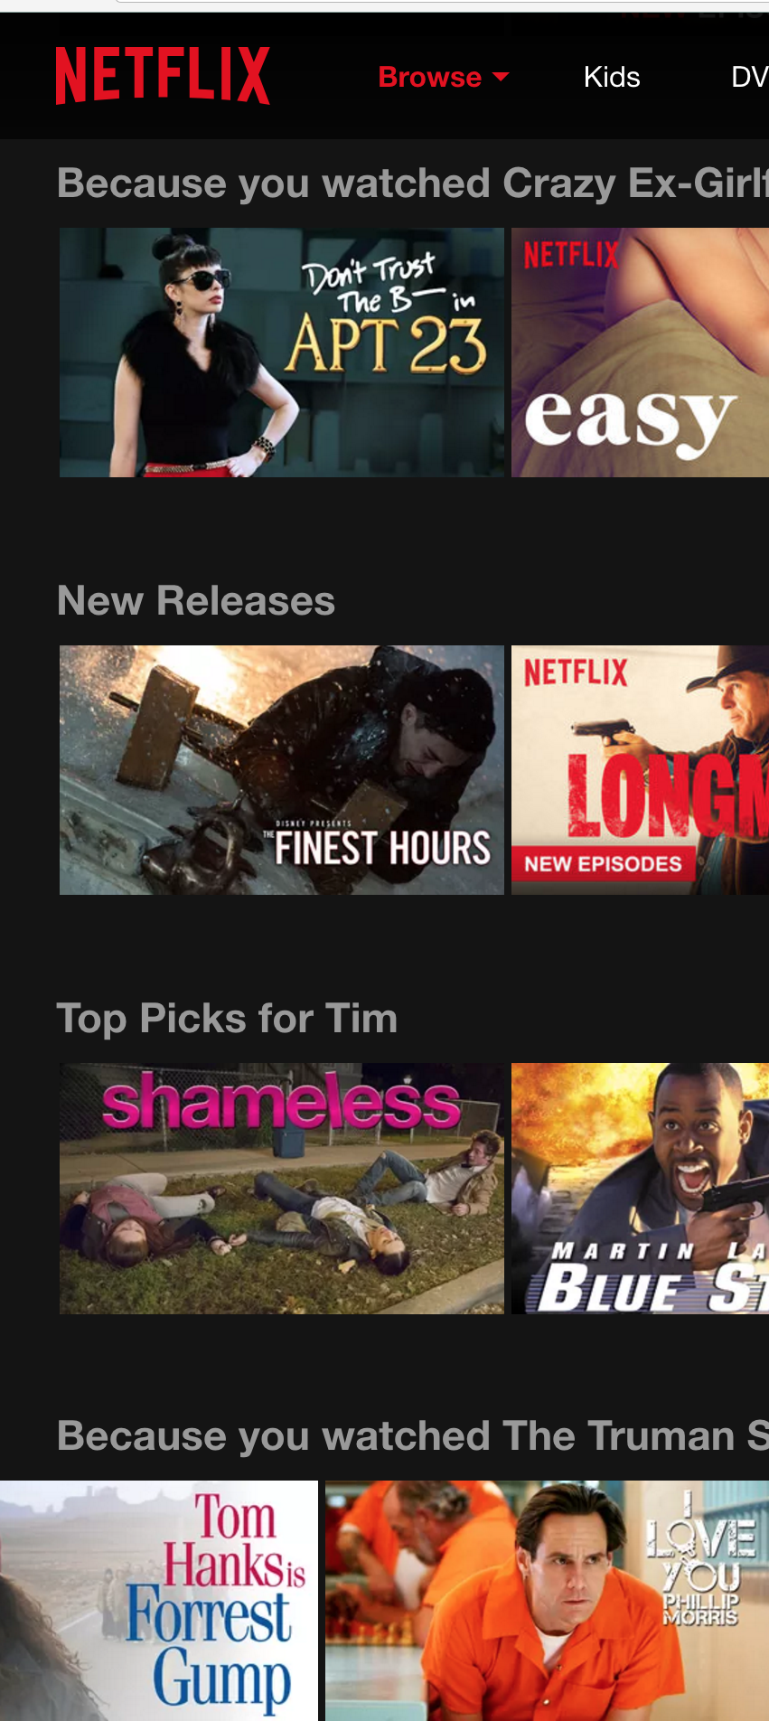
Imagine…
Imagine having to search for new movies to watch with terms:
Terminator with time travel
Sleepless in Seattle without seattle, or being sleepless
Starwars in medevil times
Frustrating, inefficient, and slow
We don’t know the title of what we haven’t seen
This is exactly the current process for Job Searching

Slide 3
Introduction: Job Searching
You
Job Searching is difficult
Putting in a list of guessed terms
Unfortunately “data” and “science” are very generic. Unlike “line cook” or “CPA accountant”
Searching on the web: Spray and Pray
Can’t Data science help us find/understand the Data science industry?
Resume
APPLICATION
HELL
Data Science?
Job posting
Job posting
Job posting
Industry

Slide 4
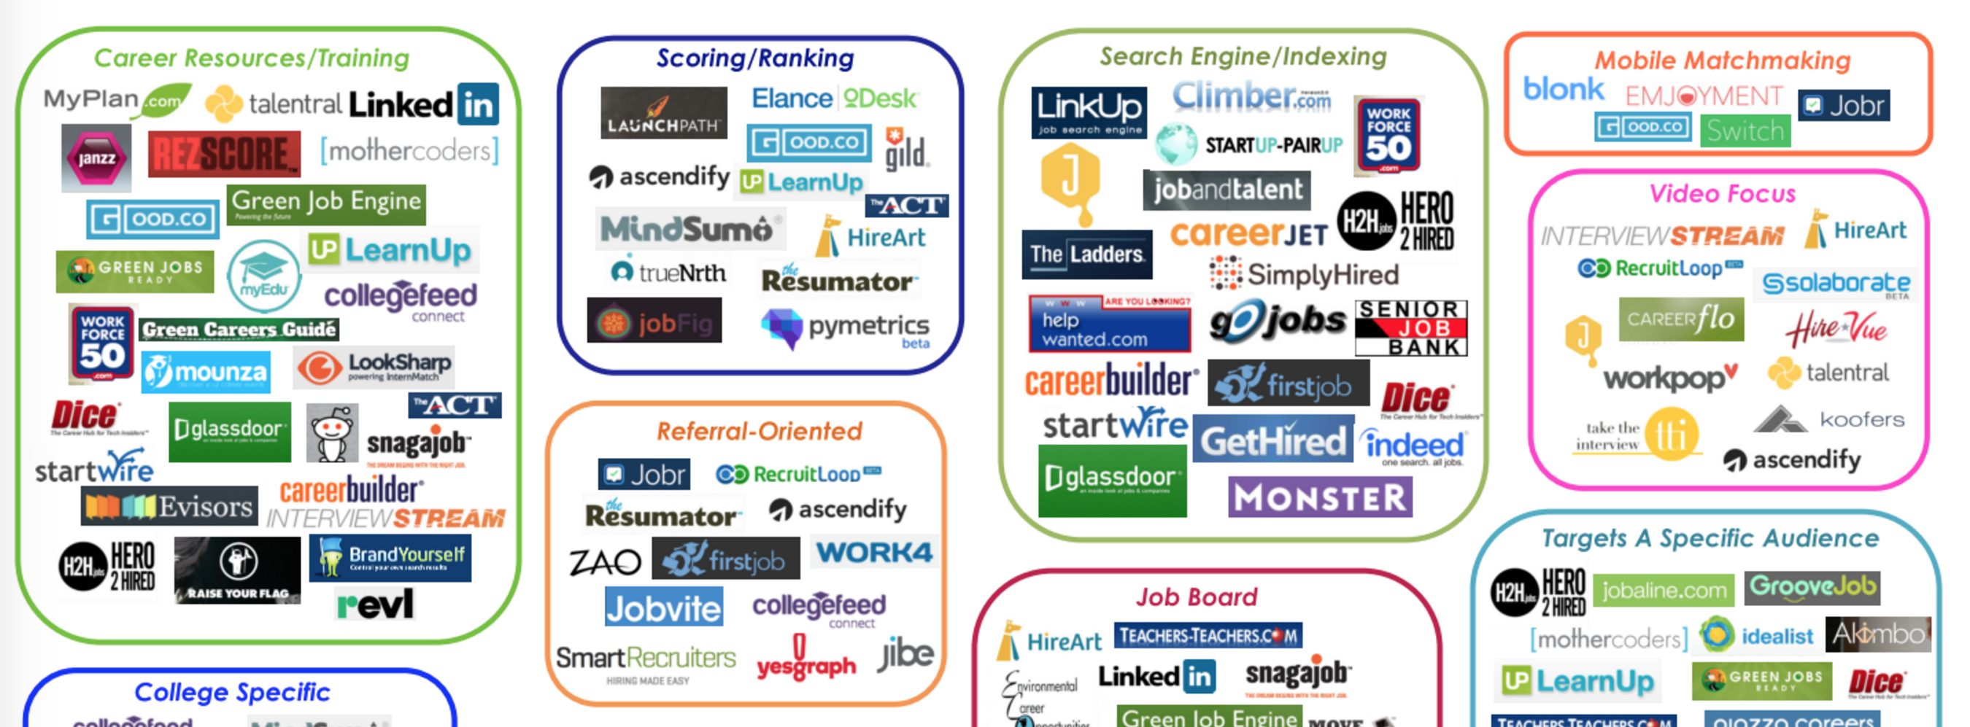
Problem Statement
Can job postings be used to predict job titles?
Can data science help us apply to jobs?
What can job postings tell us about the Data Science Industry?
?
Webscraping
Job Postings
From the web
NLP + Data Science
Data Scientist
?
Job Website
Referral
Company
Data Engineer
Data
Analyst
?
Company Websites
?
How does Data Science look in industry?

Slide 5
Feature Extraction from Text
Dataset #1: Full Text Posting
LinkedIn’s Business Analytics team uses data analysis to drive our monetization efforts. Our team is rapidly reinventing the way that proprietary data can drive sales / marketing efforts and product decisions. We now need a talented and driven team member to accelerate our efforts and be a major part of our data-centric culture. This person will work closely with marketing, engineering and data infrastructure team to prototype and develop scalable data-driven applications. A successful candidate will be both technically strong and business savvy, with a collaborative and resourceful style that’s contagious. Responsibilities: Overall, a highly driven, results-oriented, creative and nimble problem solver and a willingness to do “whatever it takes” to deliver business impact quickly. Ability to prioritize and set direction in a semi-chaotic fast moving environment
Work with a team of high-performing analytics professionals, Front-end engineers and data engineers to build scalable data applications
Propose venture ideas and quickly turn them into real-word prototype for validation
Create and share a strategic vision for the team. Build high-performance culture marked by fearlessness and hyper productivity
Effectively communicates complex analytics to broader audience in writing and presentation formats.
Basic Qualifications: Bachelors degree in a quantitative field such as Computer Science, Engineering, Operational Research, Statistics, Economics, etc.
3+ years' experience working in an Analytics, Data Science, or Engineering function
Experience using SQL
Experience coding in Python, Java, or equivalent
Experience communicating with non-technical colleagues
Highly Preferred Qualifications: Masters degree in a quantitative field such as Computer Science, Engineering, Operational Research, Statistics, Economics, etc.
5+ years’ experience working in an Analytics, Data Science or Engineering function
Experience working in the consumer web/internet domain
Experience with large-scale data on Hadoop
Web development experience (Javascript/CSS/HTML/D3/Highcharts)
Experience with statistical programming environments like R or equivalent
Experience with data mining, modeling, or machine learning a plus
The engineering culture at LinkedIn is based on building and integrating cutting-edge technologies while encouraging creativity, innovation, and expansion. Our engineers constantly raise the bar for excellence, motivating each other to tackle challenges and take intelligent risks. The industry is moving fast and our engineers are right there with it! http://engineering.linkedin.com/
Dataset #2 Line Items
Dataset # 3 Hard Skills
Basic Qualifications: Bachelors degree in a quantitative field such as Computer Science, Engineering, Operational Research, Statistics, Economics, etc.
3+ years' experience working in an Analytics, Data Science, or Engineering function
Experience using SQL
Experience coding in Python, Java, or equivalent
Experience communicating with non-technical colleagues
Highly Preferred Qualifications: Masters degree in a quantitative field such as Computer Science, Engineering, Operational Research, Statistics, Economics, etc.
5+ years’ experience working in an Analytics, Data Science or Engineering function
Experience working in the consumer web/internet domain
Experience with large-scale data on Hadoop
Web development experience (Javascript/CSS/HTML/D3/Highcharts)
Experience with statistical programming environments like R or equivalent
Experience with data mining, modeling, or machine learning a plus
Basic Qualifications: Bachelors degree in a quantitative field such as Computer Science, Engineering, Operational Research, Statistics, Economics, etc.
3+ years' experience working in an Analytics, Data Science, or Engineering function
Experience using SQL
Experience coding in Python, Java, or equivalent
Experience communicating with non-technical colleagues
Scaped 22,000 full HTML job postings from the internet

Slide 6
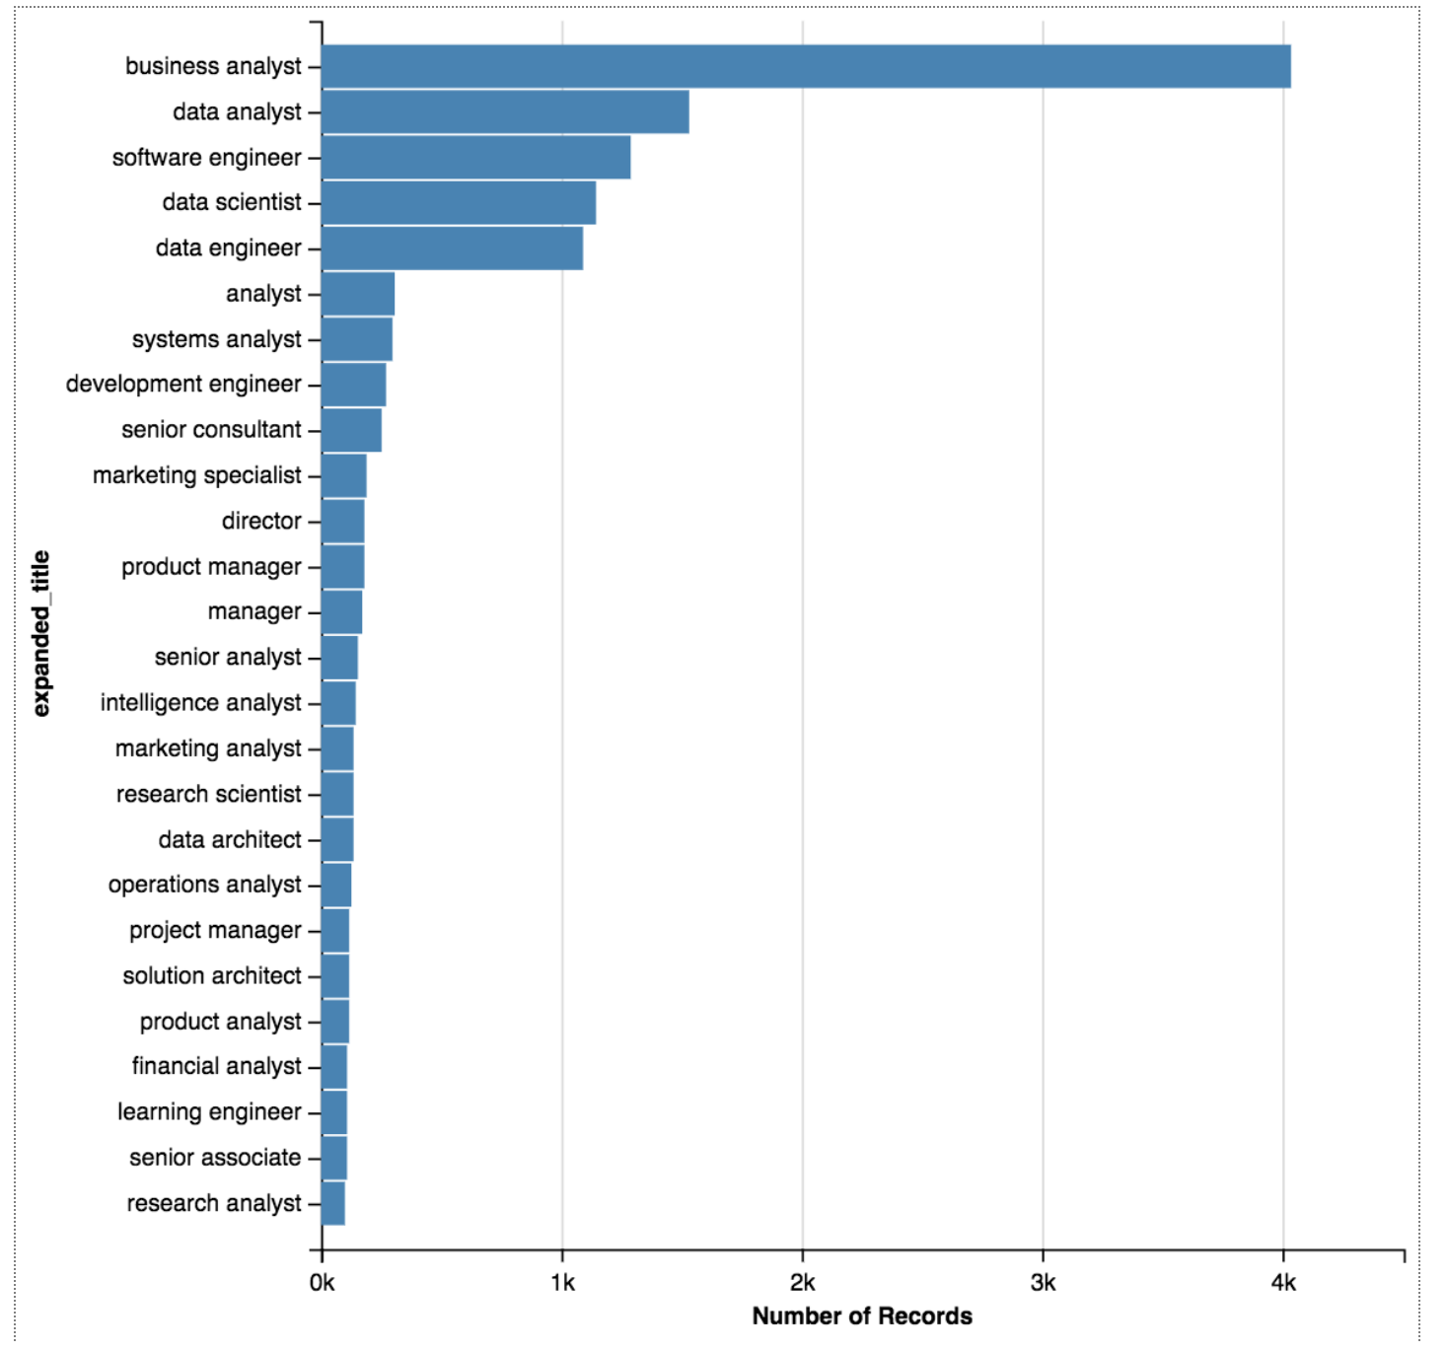
Baseline Titles
Out of 22,000 job postings
High frequency titles totaling 12,000 will be considered
Long titles are reduced. E.g.“Senior Marketing Data Analyst”, and “Data Analyst of Cancer Research” are reduced down to “Data Analyst”
Baseline Distribution
Business Analyst: 33%
Data Analyst: 12%
Software Eng: 11%
Data Scientist: 10%
Data Engineer: 10%
All Others <2%

Slide 7
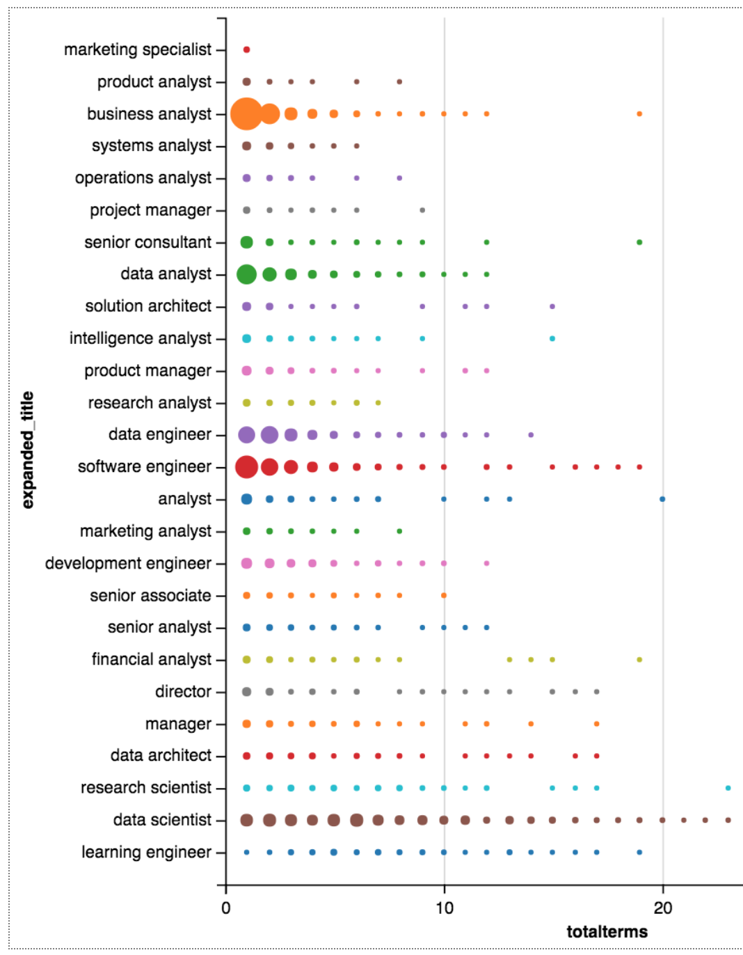
Postings with Data Science Terms
’data science’, ‘deep learning’, ’machine learning’… were counted in all job postings collected
Top job titles:
Data scientist
Research Scientist
Learning Engineer
Software engineer
Data Engineer
Financial Analyst
Data Analyst

Slide 8
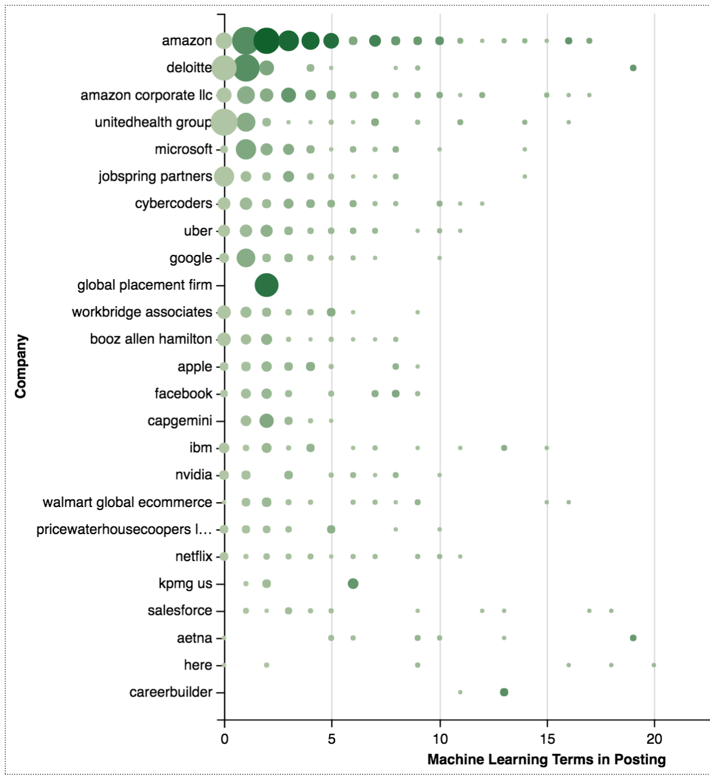
Companies with Machine Learning
Top companies with concentration of machine-learning related job postings companies from extraction (Sep 2016)
Amazon
UnitedHealth
Microsoft
Google
IBM
SalesForce

Slide 9
Features: Word Vectorizing
Raw Text
Python Tools
Abstract Text into Math Matrices
Run Data science Statistical
Models for predictions
Experience working in the consumer web/internet domain Experience with large-scale data on Hadoop Web development experience (Javascript/CSS/HTML/D3/Highcharts)
Experience with statistical programming environments like R or equivalent. Experience with data mining, modeling, or machine learning a plus
['Experience’,
'working',
'in',
'the',
'consumer',
'web/internet',
'domain',
'Experience',
'with',
'large-scale',
'data',
'on',
'Hadoop',
'Web',
'development',
Count Vectorizer
'Javascript',
'CSS',
'HTML',
'D3',
'Highcharts',
'Experience',
'with',
'statistical',
'programming',
'environments',
'like',
'R',
'or',
'equivalent',
'Experience',
'with',
'data',
'mining,',
'modeling,',
'or',
'machine',
'learning',
'a',
'plus’]
TFID Vectorizer

Slide 10
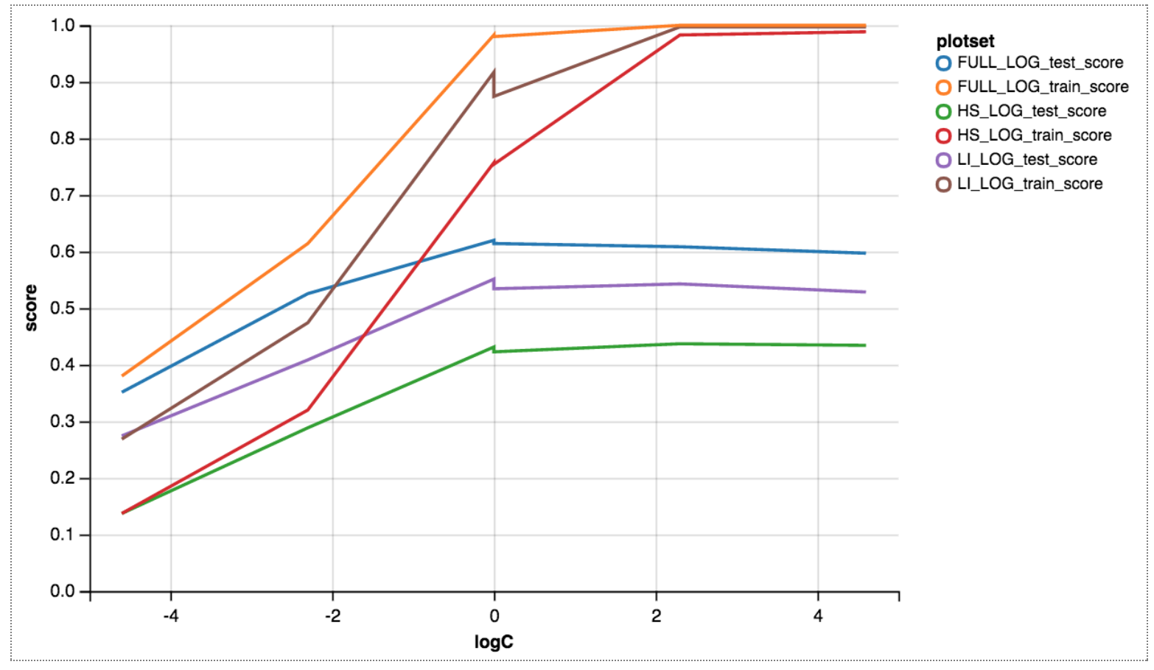
Logistic Regression Results ~0.6
Training Scores
Multi-class logistic regression
Classification scores by Log C scale. (Reg. Constant)
C regularized values of
0.01 ~ -4
0.1 ~ -2
0.0 ~ 0
1.0 ~ 2
10.0 ~ 4
100.0 ~ 6
Test Scores
C=0.1 Will choose regularization rate where the training score and testing score become closer; a more generalized model
Full Text – Over all has higher predictive power, with more words

Slide 11
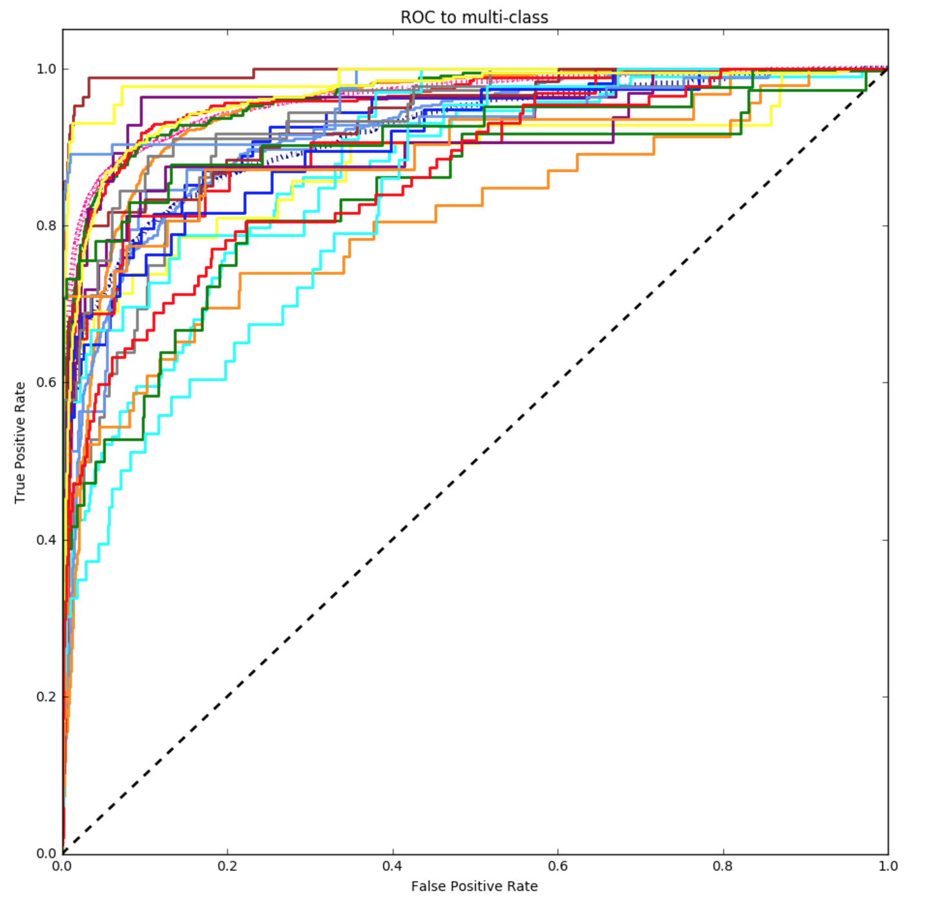
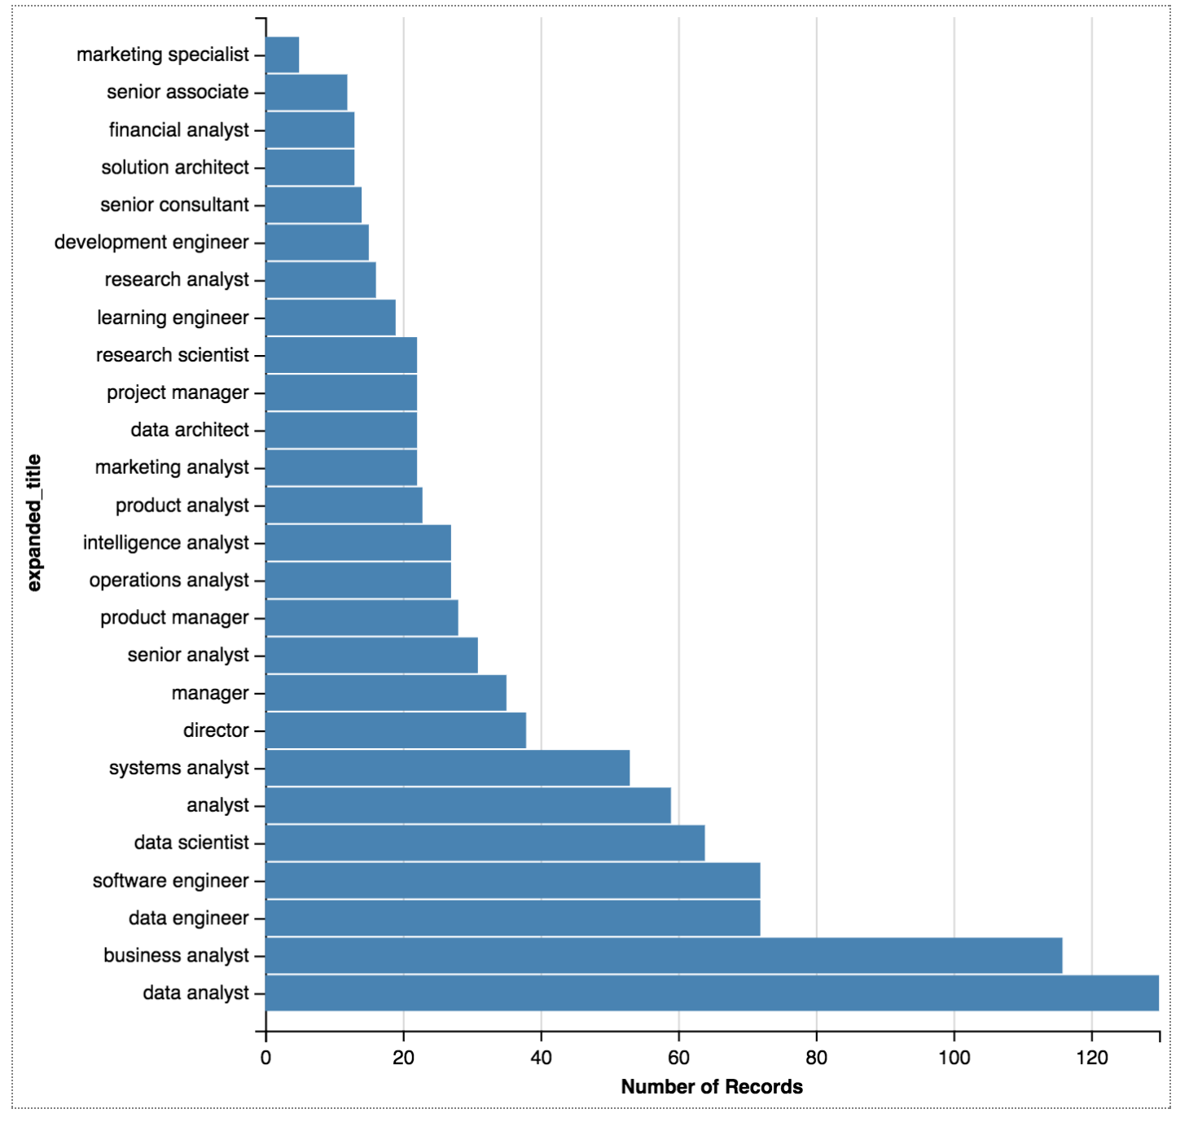
ROC Curve
To the right is the ROC curves for all 26 different predicted titles.
The poorest performing titles:
business analysts
data analysts
data engineer
Software engineer
data scientist

Slide 12
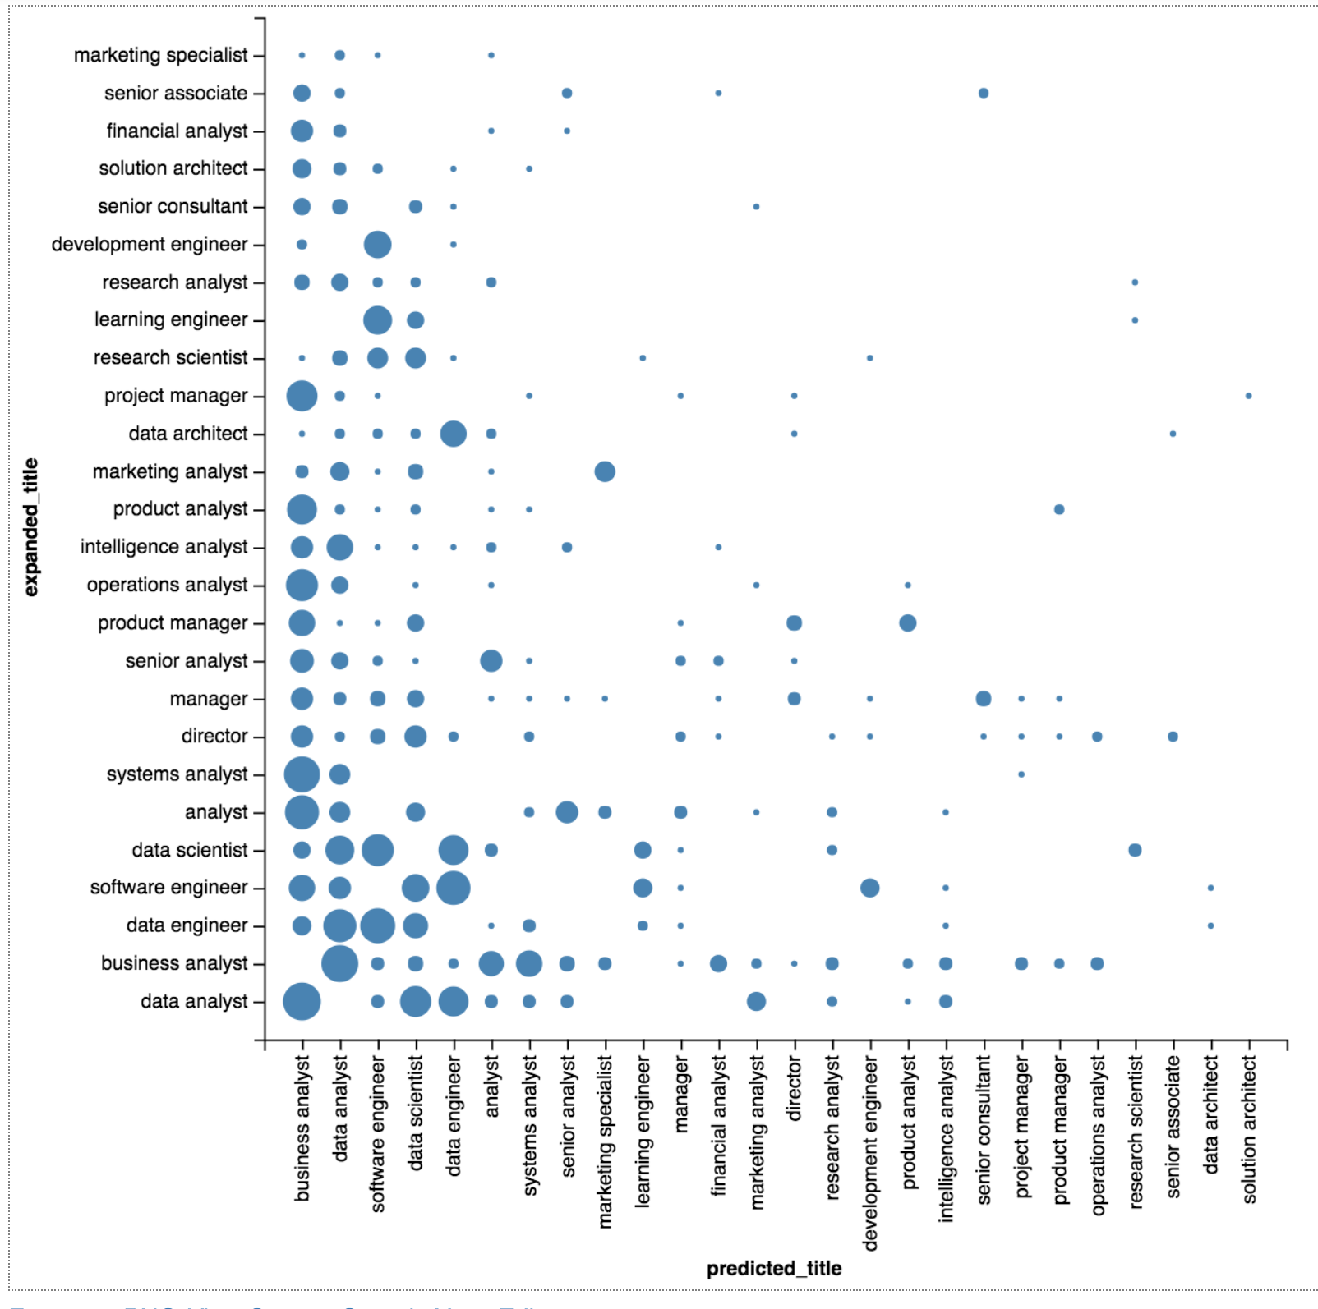
What wrong titles were assigned?
All the ”analyst” positions are very similar
Data scientist mis-predicted as these:
data analyst,
software engineer,
data engineer,
learning engineer,
business analyst,
research scientist

Slide 13
Takeaways
Data Scientist is hidden in other titles: job postings have many same characteristics with data engineering, learning engineer, or data analyst
Unfortunately data analyst titles are general : and are intermingled with system analyst, business analyst, senior analyst
Data science is out there, though small: Even though CA is the biggest data science hub, there are smaller pockets of data science in the US even throughout the US. An additional time analysis can measure the growth of data science

Slide 14
Appendix

Slide 15
Bonus: NLP Topic Modeling for Better Recommendations
LDA Topic modeling was performed with full text, line item, and hard skill excerpts.
The topic probabilities are then used to build an recommendation engine, and job postings can be clustered around topics
Software Engineer
Software Dev
Topic
Data
Engineer
LDA
['Experience’,
'working',
'in',
'the',
'consumer',
'web/internet',
'domain',
'Experience',
'with',
'Javascript',
'CSS',
'HTML',
'D3',
'Highcharts',
'Experience',
'with',
'statistical',
Data
Scientist
Data
Analyst
Latent
Dirichlet
Allocation
Statistics Research
Topic
Data
Scientist
Data
Analyst
Data
Analyst

Slide 16
Sample Topics Extracted from Different Data Sources
Full Job Posting Source Materials |  |  |  | Hard Skill Posting Source Materials
Generic Business | Machine Learning Software | Data / Stats Analyst | Web Developer | Generic Business | Big Data / Tech Heavy | Consulting / | Reporting / Databases
business + requirements + experience + project + management + skills + ability + work') | experience + learning + data + team + machine + work + software + science') | data + analytics + business + experience + analysis + statistical + insights + skills') | experience + software + development + design + technical + systems + applications + web') | business + requirements + project + process + development + management + technical + functional') | data + java + hadoop + big + experience + systems + python + technologies') | environment + fast + paced + work + business + team + data + effectively') | data + business + sql + reporting + tools + analysis + analytics + reports')

Slide 17
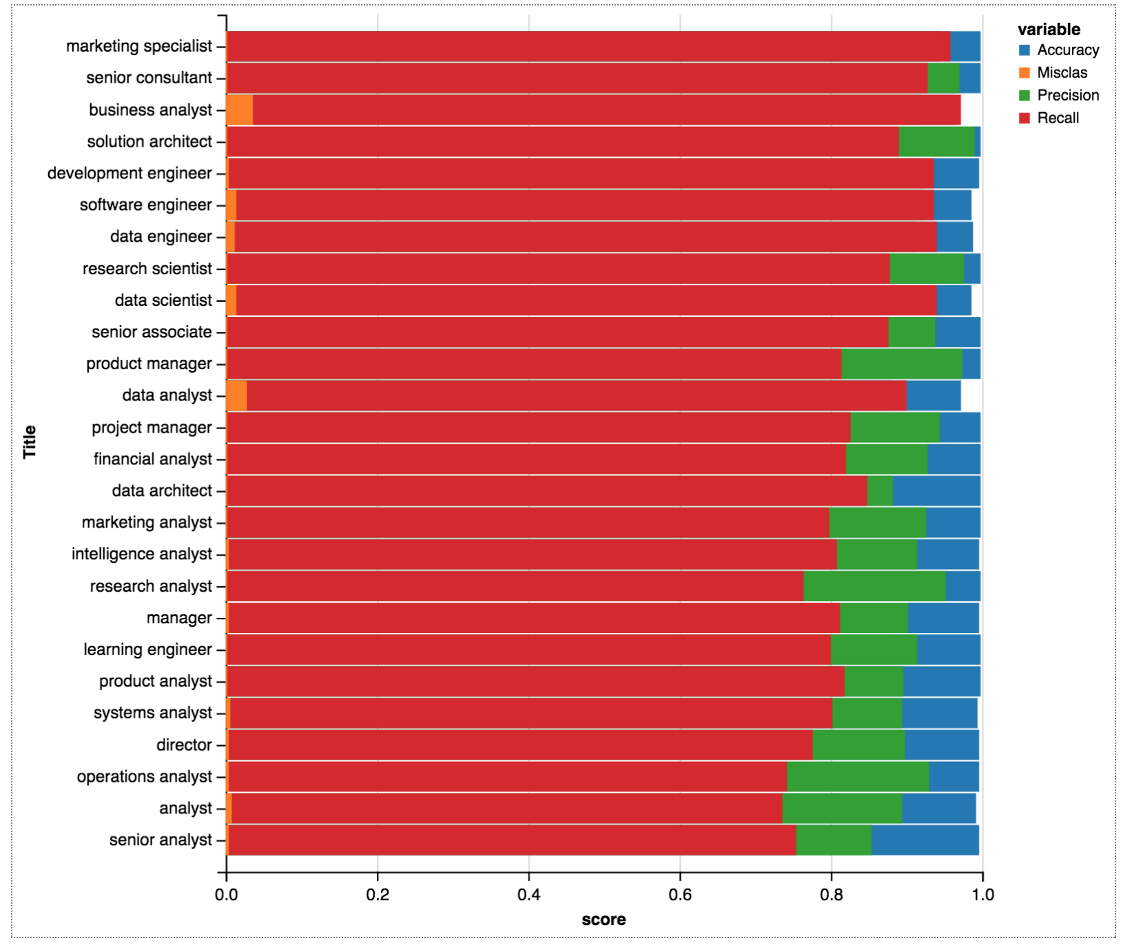
Confusion Matrix
Overall high accuracy. Lowest recall is clustered around the “Analyst” job titles

Slide 18
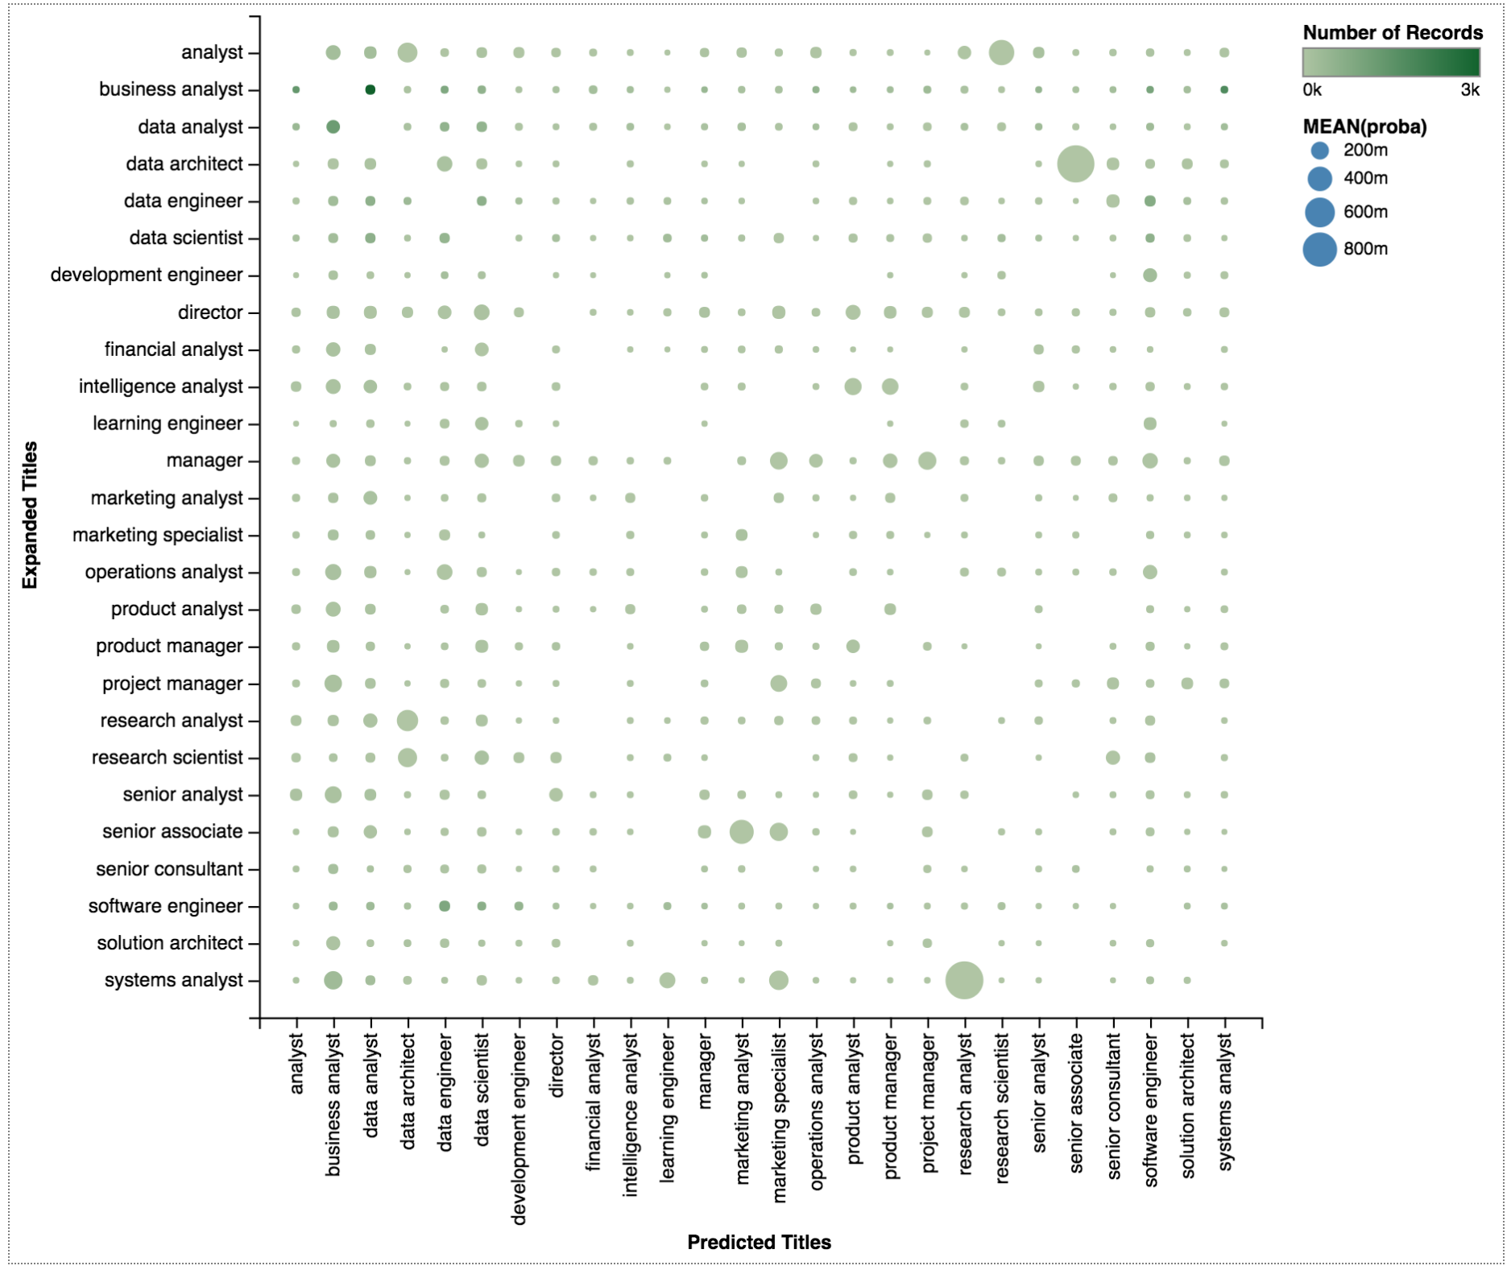
Title Similarity
After using logistic regression, we have a probability table.
Data scientist has relations to:
Data analyst
Data Engineer
Marketing Spec.
Product Analyst
Research Sci.
Software Eng.

Slide 19
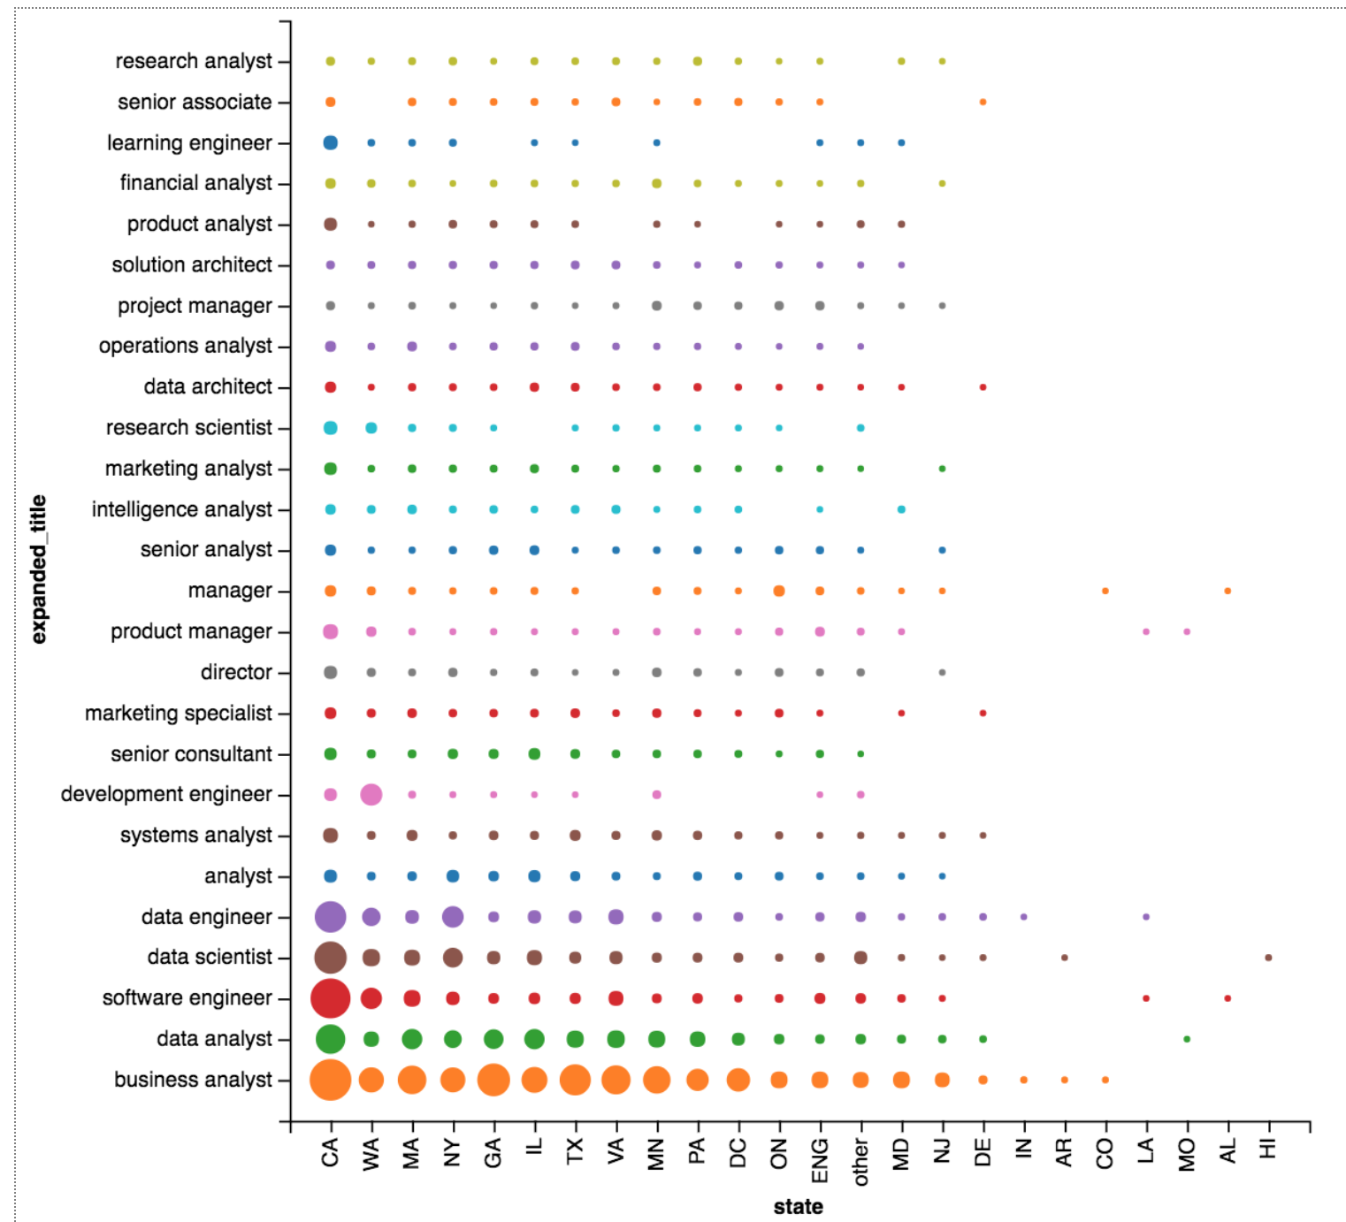
Job Titles by State
Aside from CA, NYC, there are machine learning opportunities in
WA
DC
MA
GA
VA
TX

